Slide 1
WP 2 Purchase of training equipment and training materials
MediTec
Kick off Meeting
22.02.2018

Slide 2
WP3: Purchase of training equipment and
training materials
Estimated Start Date : 15-03-2018
Estimated End Date : 15-08-2018
The work package consist of 2 tasks:
Delivery of technical and didactic equipment : 15-06-2018 to 15-07- 2018
Selection of the equipment ( hardware and software)
Purchase and delivery the equipment
2.Hardware installation and adjustment of software: 15-07-2018 to 15-08- 2018
Equipped rooms for the MediTec Center (furniture, electricity, Internet and etc.)
Installation and opening the Center

Slide 3
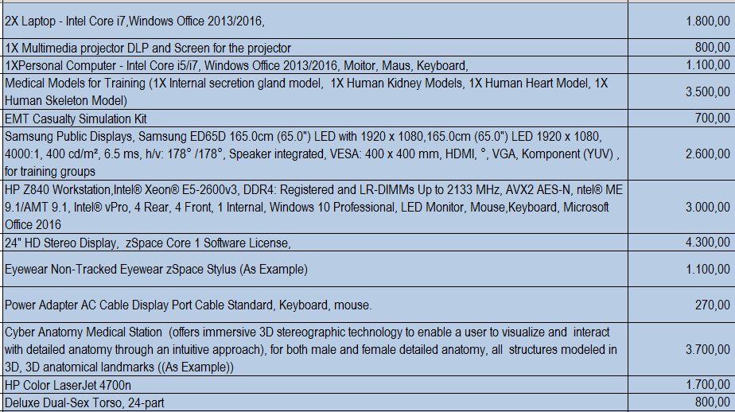
Equipment
25.370,00 Euro for each partner from partner countries
Except one partner , which get 4.700,00 Euro
Equipment as one Package

Slide 4
How to buy the Equipment?
Needs:
Need 3 Offers from 3 different companies (List of needed equipment )
Justification letter: Choose the best offer→ why did you choose this offer?→ template…… cheepest one, best quality, 24h services, ….
Contract between partner university and the supplier → to deliver the equipment → template……contract as a guarantee for security
Invoices for the chosen equipment → template
Inventory list for the chosen equipment → template
Note: partners don’t need printer and projector and will buy other devices ??? → yes/no, reason, have to ask

Slide 5
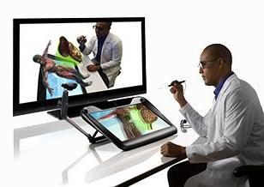
Interactive Anatomy
VR Monitor and Computer System
Anatomy Software: A perpetual license to activate CyberAnatomy VR on the zSpace platform on a single machine. Product updates and support included.
Software Details: Over 13,500 anatomical objects with medical level of detail and landmarks, Labeling in accordance with Anatomica Termilogica, Extensive review by medical professionals, and Full quizzing and search features supported.
Systems: Skeleton – Bones, Skeletal Tissues and Joints, Muscular - Muscles and Muscle Tissue, Nervous System and Nervous Tissue, The Brain and Peripheral Nervous System,
The Cardiovascular System: The Heart,
The Cardiovascular System: Blood Vessels, The Lymphatic System, The Respiratory System, The Digestive System,
The Urinary System, The Reproductive System, and Skin, as well as detailed eye and ear.

Slide 6
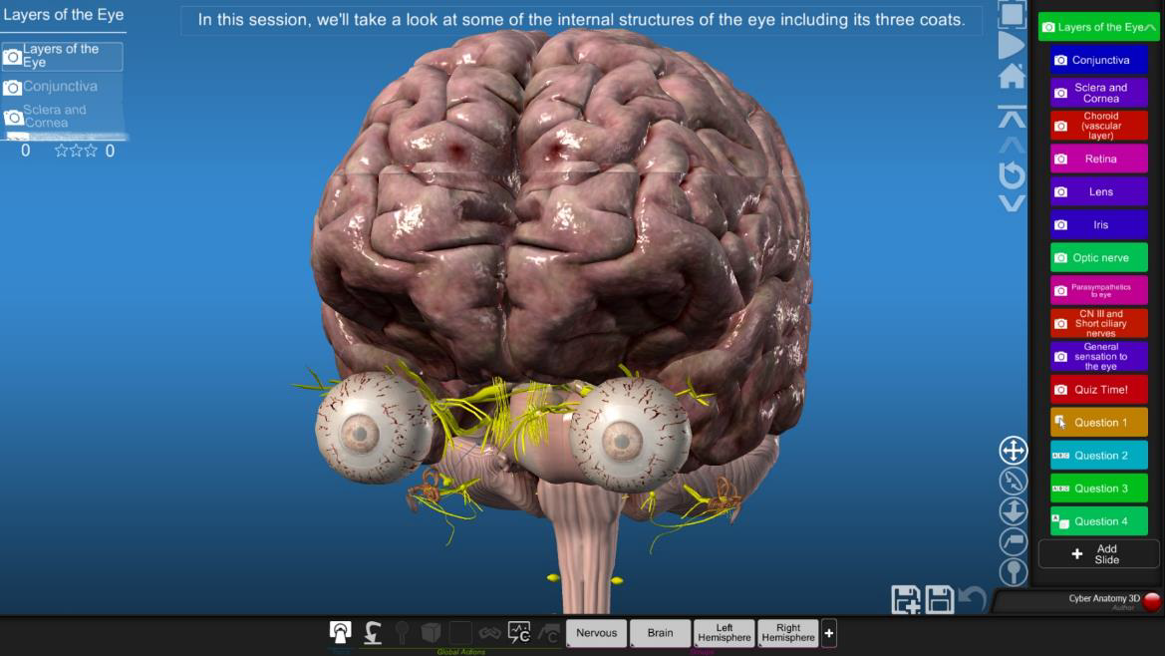
Anatomy - Author

Slide 7
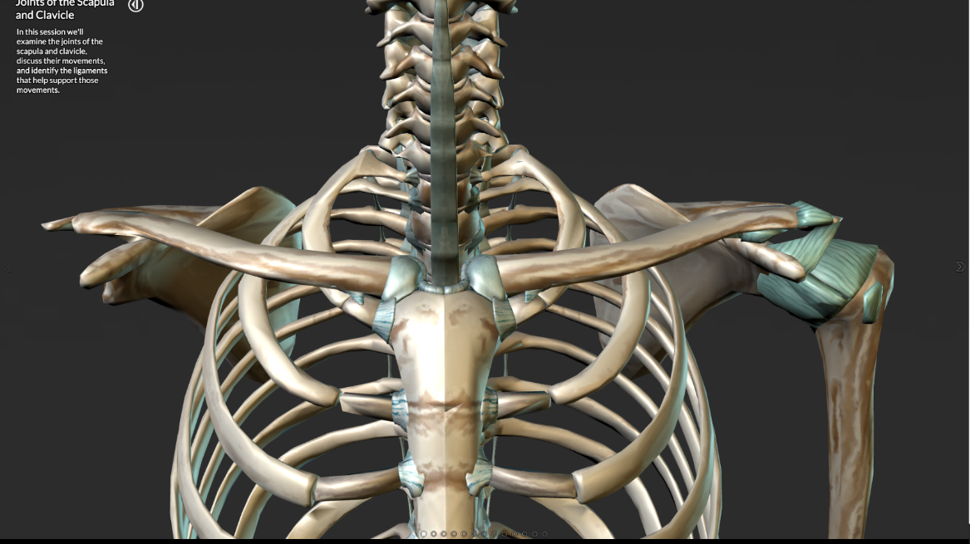
Anatomy - Viewer

Slide 8
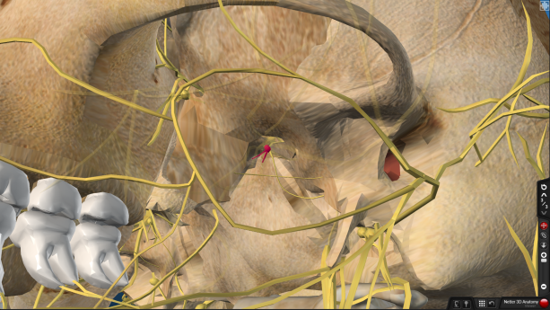
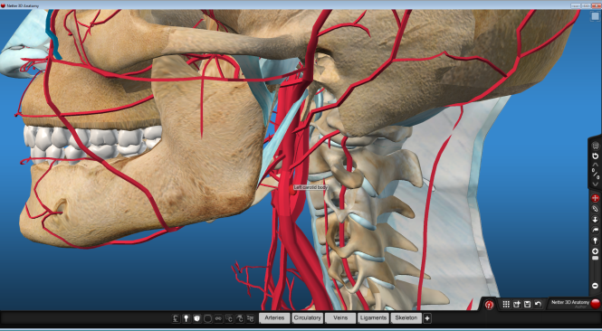
Anatomy - Systems
Skeleton – Bones, Skeletal Tissues and Joints
Muscular - Muscles and Muscle Tissue
Nervous System and Nervous Tissue
The Brain and Peripheral Nervous System
The Endocrine System
The Cardiovascular System: The Heart
The Cardiovascular System: Blood Vessels
The Lymphatic System
The Respiratory System
The Digestive System
The Urinary System
The Reproductive System
Skin, as well as detailed eye and ear

Slide 9
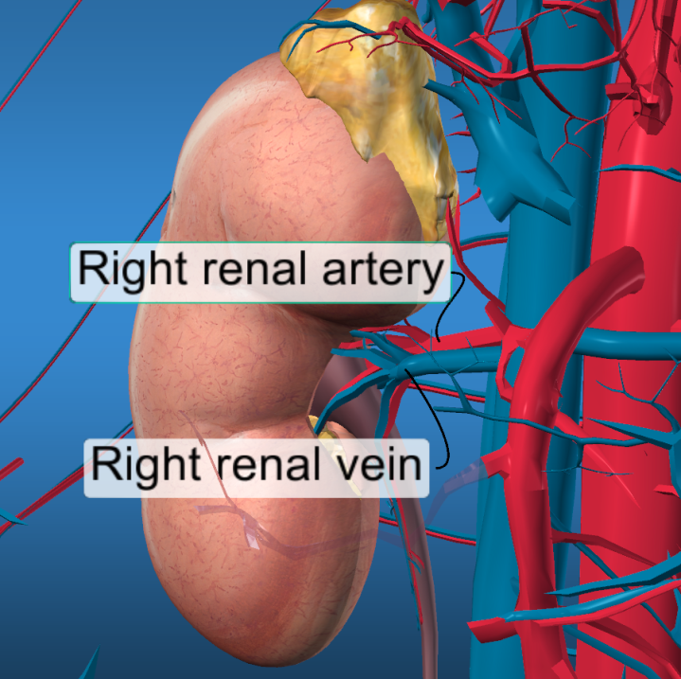
Anatomy - Features
Over 13,500 anatomical objects with medical level of detail and landmarks
Labeling in accordance with Anatomica Termilogica
Extensive review by medical professionals
Full quizzing and search features supported
Elsevier private branded version includes correlation to Netter plates

Slide 10
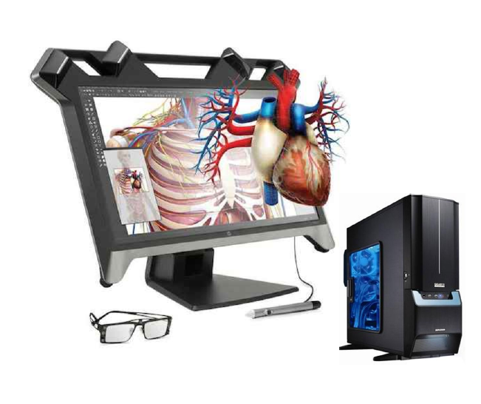
Anatomy VR
Anatomy VR solution
includes:
VR Monitor – 24”
VR passive glasses
VR computer
VR Stylus
VR content

